Slide 1
Statements and flow control
Prepared By: P.Pirapuraj
Source: http://www.cplusplus.com/doc/tutorial/control/

Slide 2
Statements
A simple C++ statement is each of the individual instructions of a program, like the variable declarations and expressions seen in previous sections.
They always end with a semicolon (;), and are executed in the same order in which they appear in a program.
But programs are not limited to a linear sequence of statements. During its process, a program may repeat segments of code, or take decisions and bifurcate.
For that purpose, C++ provides flow control statements that serve to specify what has to be done by our program, when, and under which circumstances.

Slide 3
Statements…
Many of the flow control statements explained in this section require a generic (sub)statement as part of its syntax.
This statement may either be a simple C++ statement, -such as a single instruction, terminated with a semicolon (;) - or a compound statement.
A compound statement is a group of statements (each of them terminated by its own semicolon), but all grouped together in a block, enclosed in curly braces: {}:

Slide 4
C++ decision making statements
Decision making structures require that the programmer specify one or more conditions to be evaluated or tested by the program, along with a statement or statements to be executed if the condition is determined to be true, and optionally, other statements to be executed if the condition is determined to be false.
Following is the general form of a typical decision making structure found in most of the programming languages −

Slide 5
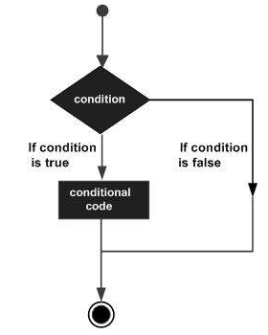

Slide 6
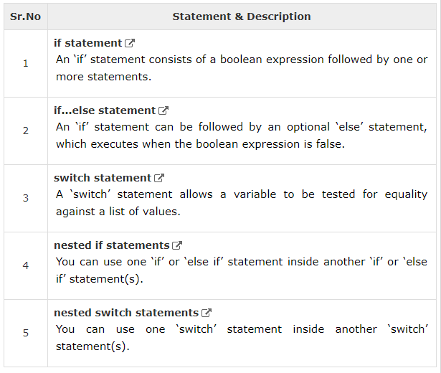

Slide 7

C++ if statement
An if statement consists of a boolean expression followed by one or more statements.
Syntax
If the boolean expression evaluates to true, then the block of code inside the if statement will be executed. If boolean expression evaluates to false, then the first set of code after the end of the if statement (after the closing curly brace) will be executed.

Slide 8
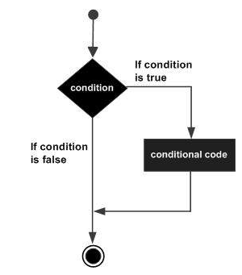
C++ if statement…
Flow Diagram

Slide 9

C++ if statement…
Example
#include <iostream>
using namespace std;
int main () {
// local variable declaration:
int a = 10;
// check the boolean condition
if( a < 20 ) {
// if condition is true then print the following
cout << "a is less than 20." << endl;
}
cout << "value of a is : " << a << endl;
return 0;
}

Slide 10
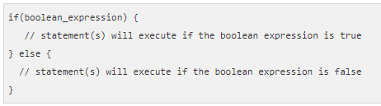
C++ if...else statement
An if statement can be followed by an optional else statement, which executes when the boolean expression is false.
Syntax
If the boolean expression evaluates to true, then the if block of code will be executed, otherwise else block of code will be executed.

Slide 11
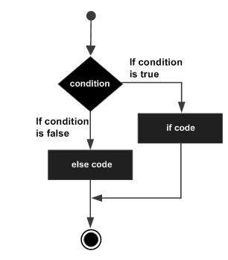
C++ if...else statement…
Flow Diagram

Slide 12
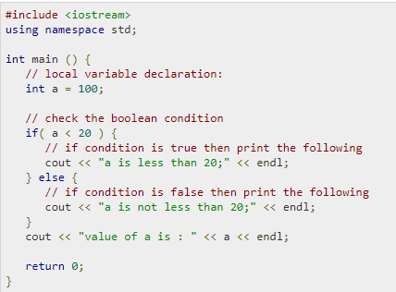
C++ if...else statement…
Example

Slide 13
if...else if...else Statement
An if statement can be followed by an optional else if...else statement, which is very useful to test various conditions using single if...else if statement.
When using if , else if , else statements there are few points to keep in mind.
An if can have zero or one else's and it must come after any else if's.
An if can have zero to many else if's and they must come before the else.
Once an else if succeeds, none of he remaining else if's or else's will be tested.

Slide 14
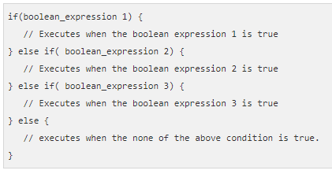
if...else if...else Statement…
Syntax

Slide 15
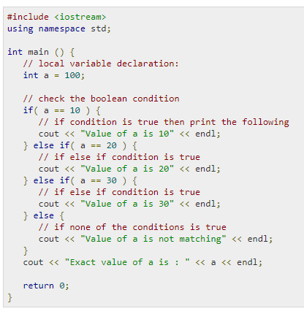
if...else if...else Statement…
Example

Slide 16
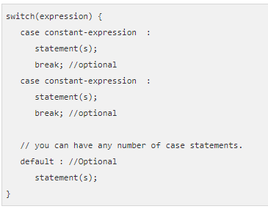
C++ switch statement
A switch statement allows a variable to be tested for equality against a list of values. Each value is called a case, and the variable being switched on is checked for each case.
Syntax

Slide 17
C++ switch statement…
You can have any number of case statements within a switch. Each case is followed by the value to be compared to and a colon.
The constant-expression for a case must be the same data type as the variable in the switch, and it must be a constant or a literal.
When the variable being switched on is equal to a case, the statements following that case will execute until a break statement is reached.
When a break statement is reached, the switch terminates, and the flow of control jumps to the next line following the switch statement.

Slide 18
C++ switch statement…
Not every case needs to contain a break. If no break appears, the flow of control will fall through to subsequent cases until a break is reached.
A switch statement can have an optional default case, which must appear at the end of the switch. The default case can be used for performing a task when none of the cases is true. No break is needed in the default case.

Slide 19
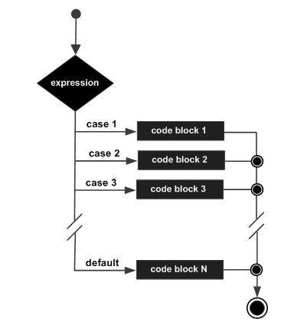
C++ switch statement…(Flow Diagram)

Slide 20
C++ switch statement…(Example)
#include <iostream>
using namespace std;
int main () {
// local variable declaration:
int marks ;
cout<<“Enter Your marks”<<endl;
cin>>marks;
switch(marks) {
case 80 :
cout << "Excellent!" << endl;
break;
case 60 :
case 50 :
cout << "Well done" << endl;
break;
case 40 :
cout << "You passed" << endl;
break;
case 30 :
cout << "Better try again" << endl;
break;
default :
cout << "Invalid grade" << endl;
}
//cout << "Your grade is " << grade << endl;
return 0;
}

Slide 21
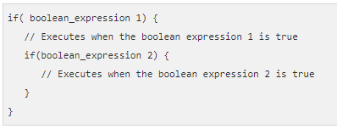
C++ nested if statements
It is always legal to nest if-else statements, which means you can use one if or else if statement inside another if or else if statement(s).
Syntax

Slide 22

C++ nested if statements…
#include <iostream>
using namespace std;
int main () {
// local variable declaration:
int a = 100;
int b = 200;
// check the boolean condition
if( a == 100 ) {
// if condition is true then check the following
if( b == 200 ) {
// if condition is true then print the following
cout << "Value of a is 100 and b is 200" << endl;
}
}
cout << "Exact value of a is : " << a << endl;
cout << "Exact value of b is : " << b << endl;
return 0;
}

